Slide 2
PATHWAY = a way of achieving a desired result; a course of action

Slide 3
“ CHOOSE for yourselves this day whom you will serve, whether the gods your ancestors served beyond the Euphrates, or the gods of the Amorites, in whose land you are living. But as for ME and MY HOUSEHOLD, we will serve the Lord.”
(Joshua 24:15)

Slide 4
Trail Marker #1: Christ-Focused Learning
Christianity is Christ!
It is not a lifestyle, rules of conduct, or an organization. It is a relationship with Jesus who is Christ the Lord.
Christ-focused learning is about loving Jesus and His way of approaching life.
It starts with you being Christ-focused yourself.

Slide 5
PRE-DECISION = You already have a conviction about something so you know if you are going to do it or not going to do it ahead of time.

Slide 6
Trail Marker #1: Christ-Focused Learning
1
Loving Jesus
Jesus said, “Let the little children come to me, and do not hinder them, for the kingdom of heaven belongs to such as these.”
(Matthew 19:14)

Slide 7
Trail Marker #1: Christ-Focused Learning
2
Loving Jesus
Wanting that relationship with Jesus

Slide 8
Trail Marker #1: Christ-Focused Learning
3
Loving Jesus
Wanting that relationship with Jesus
Loving His Word
What message are you sending about the importance of God’s Word in your home?
Is it a priority? Are you planning for it?

Slide 9
Trail Marker #1: Christ-Focused Learning
4
Loving Jesus
Wanting that relationship with Jesus
Loving His Word
Knowing Their Identity in Christ
In Christ, a dearly loved child of God, one of God’s saints with the Holy Spirit living inside them to help them live to please God

Slide 10
Trail Marker #1: Christ-Focused Learning
5
Loving Jesus
Wanting that relationship with Jesus
Loving His Word
Knowing Their Identity in Christ
Understanding God’s grace
Motivation to obey God should be because of love and gratitude for what He has done.

Slide 11
Trail Marker #1: Christ-Focused Learning
6
Loving Jesus
Wanting that relationship with Jesus
Loving His Word
Knowing Their Identity in Christ
Understanding God’s grace
Pushing them towards dependence on Christ

Slide 12
Key truth…
6
Human parents raise their children to be less dependent on them and more independent of them.
But God raises His children to be less independent of Him and MORE DEPENDENT on Him.

Slide 13
Trail Marker #1: Christ-Focused Learning
7
Loving Jesus
Wanting that relationship with Jesus
Loving His Word
Knowing Their Identity in Christ
Understanding God’s grace
Pushing them towards dependence on Christ
Leading them to mature faith of their own

Slide 14
Trail Marker #2: The Family Team
Stay within sight and sound of the group
Team Community—inside the home
Team Activities—outside the home

Slide 15
Trail Marker #2: The Family Team
Team Community—inside the home
Serving one another
Chores are opportunities to serve one another in love.
Sharing with one another

Slide 16
Trail Marker #2: The Family Team
Team Community—inside the home
Serving one another
Chores are opportunities to serve one another in love.
Sharing with one another
Laughing together

Slide 17
Trail Marker #2: The Family Team
Team Activities—outside the home
Activities can be beneficial to the family team, OR they can rob the family of its energy and detract the family from its purpose of living to serve Jesus and please Him with your lives.
What are you allowing to take your family time? Does that fit your purpose for the whole family?

Slide 18
Trail Marker #3: Local Church Commitment
The local church is like having a good map that teaches you truth about your trail, preparing you for the challenges.
Where your children get discipled by someone besides you
Where they can learn to disciple others which makes them more dependent on Christ

Slide 19
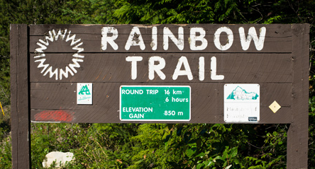
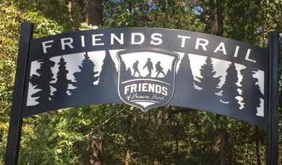
Trail Marker #3: Local Church Commitment

Slide 20
Hebrews 10:25…
not giving up meeting together (NIV)
not neglecting to gather together (CSB)
not abandoning our own meetings (NET)
as some are in the habit of doing
Jennifer

Slide 21
Trail Marker #4: Godly Mentors and Friends
“You surrounded us with God-fearing people.”
Surround children with God-fearing adults
Other Christian families
Classroom teachers and small group leaders
Be choosy about your children’s friends
They need guidance in choosing friends
Seek out and initiate contact with quality friends

